Slide 1
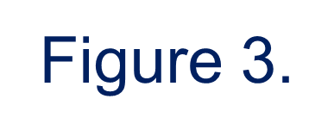
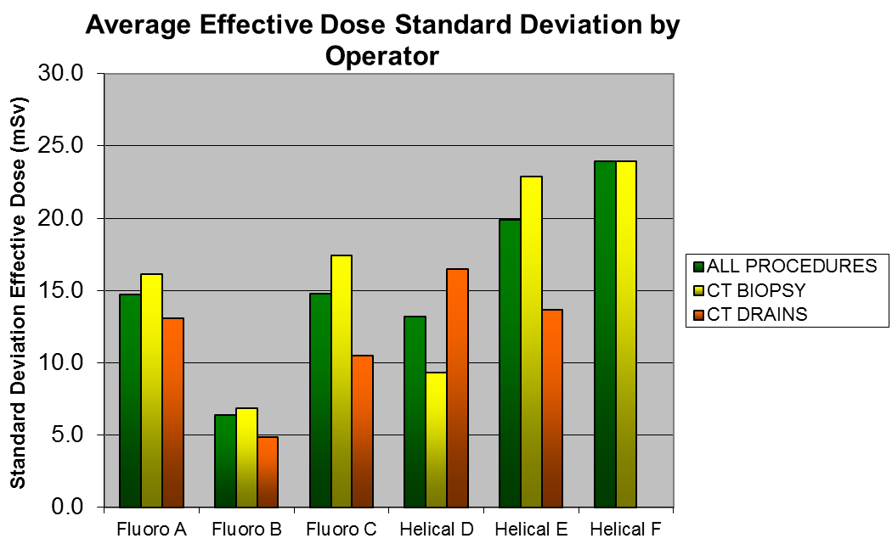
Patient dose during CT guided procedures: differences between CT fluoroscopy verses CT helical imaging.
Jordan Dixon D.O., James Cunningham D.O., Nathan Daley M.D.,
Michael Kandasawmi RTR
Department of Radiology University of Florida-College of Medicine, Jacksonville, Florida
Introduction:
Materials and Methods Continued:
Discussion:
In effort to reduce the harmful effects from radiation there are many steps and procedures that have been implemented to decrease patient and practitioner radiation dose
Each interventionist performing CT guided procedures at our institution demonstrated a preference for utilizing either fluoro CT or helical CT scanning to accomplish CT drainage or biopsy procedures
General technique for using intermittent fluoro CT mode during procedures:
Standard helical scan to localize the procedure target
Remainder of the procedure using intermittent CT fluoro
Immediate post-procedure CT fluoro to evaluate for complications (hematoma, pneumothorax, etc.)
General technique for using helical CT mode:
Helical CT for initial localization scan
Continue to use helical mode for all intra-procedural and post-procedural imaging
Literature review:
Many studies compare helical versus fluoroscopic CT guidance for numerous procedures en-block without comparing the best technique for a given procedure individually
Hypotheses:
Variations in DLP (dose length product) and variations in the quantity component of the x-ray beam (represented directly by MAs and also captured within DLP) will result in significant differences in patient dose between procedures performed in fluoro CT mode verses helical CT mode
Helical scanning generally involves a larger field of view (thus increasing DLP) and utilizing higher MAs parameters for noise reduction
Limiting helical scanning during procedures will result in lower effective doses
Practitioners utilizing CT fluoro mode are predicted to achieve lower average procedure doses
Dose estimation calculations for both patient and operator:
Effective dose in mSv was estimated from DLP multiplied by the k-factor of 0.015 (the difference between chest and body is 0.014 vs 0.015)
Fluoro procedure doses are mostly comprised of the helical component for which k-factors have been established
Intermittent fluoro doses have no established coefficient for estimating effective dose from DLP, though 0.018 has been calculated in other studies (Leng,S. AJR, 2011; 197:W97-W103).
CT fluoroscopy trends toward a lower dose
Differences in dose for CT guided drain placement and CT guided drains and biopsies combined (“all procedures”) in the 90% confidence interval (p=0.081 and p=0.097 respectively)
High operator variability (relative to the procedure dose)
Previous studies indicated the highest proportion of the dose occurs during the initial helical phase of scanning (helical imaging for lesion localization and planning) or if a helical post scan to evaluate for complications (hematoma, pneumothorax, etc.)
Minimizing the dose parameters (kvp and mAs to minimize CTDI) and the length of included anatomy (z – axis, to minimize DLP) are likely the most critical variables to consider in minimizing the procedural dose
Our study’s limitations:
372 procedures were included within our review (179 biopsies and 193 drains)
A larger sample size may achieve statistical significance (p=0.05)
It was unable to be determined retrospectively the proportion of radiation dose allotted to the “planning” helical scan and the intra-procedural proportion
The high inter-operator variability in dose may be confounded by the participation of numerous residents and fellows of various experience levels
The effective dose estimation (0.015) likely overestimates dose for thoracic procedures and underestimates all CT fluoroscopy doses
Results:
Figure 1.
Figure 1. Differences in dose between CT modes. CT fluoro demonstrated consistently lower average effective dose compared to CT fluoro for biopsies (p=0.291), drains (p=0.081), and all procedures (p=0.097)
Average effective doses for CT intermittent fluoro procedures:
18.1 mSv (SD of 13.2 mSv) for combined procedures (CT biopsy and CT drain)
19.2 mSv (SD of 14.6 mSv) for CT biopsy only
16.8 mSv (SD of 11.4 mSv) for CT drains only
Average effective doses for CT helical procedures:
20.3 mSv (SD of 18.2 mSv) for combined procedures
20.5 mSv (SD of 19.9 mSv) for CT biopsy only
19.8 mSv (SD of 15.1 mSv) for CT drain only (Table 1)
Differences in dose between CT modes did not reach statistical significance at p=0.05 (95% CI). CT fluoro demonstrated consistently lower average effective dose compared to CT fluoro for biopsies (p=0.291), drains (p=0.081), and all procedures (p=0.097) (Figure 1)
Conclusion:
Information gathered and analyzed from the Interventional Radiology department at our institution
Utilizing fluoroscopic CT mode during CT guided procedures has excellent potential to lower radiation dose when compared to exclusive use of helical mode imaging, the results are heavily operator dependent.
Consistently low effective patient doses are most likely to be achieved by promoting the use of CT intermittent flouro mode during CT guided procedures in combination with improved operator education and vigilance toward optimal dose reduction techniques.
The most important dose reduction techniques during CT fluoro procedures include limiting the field of view and MAs utilized during initial localizing helical scans, and the discriminate application of intra-procedural intermittent CT fluoro imaging
Materials and Methods:
372 procedures (179 biopsies, 193 drains) included in the analysis
CT guided procedures - performed on a Siemens Sensation 16 slice CT scanner
CTDI and DLP - based on a 32 inch dose phantom
Statistical data analysis:
Standard F test to determine equality of variance, and standard T-test for equal variance (Microsoft Corporation, 2007)
Helical scanning parameters used for CT fluoro initial scout/localizing imaging, and for all helical scan guided procedure imaging: Slice thickness 2.5 mm; pitch: 1.375; Kvp: 120; MA: min 100; max 350 with automatic dose modulation (Smart MA) turned on
CT Fluoro parameters: Slice thickness 5 mm; Kvp: 120; MA: 40; exposure time: 90 sec
Our data only reported total DLP from the procedure and the proportion of that due to helical vs fluoro components of the procedure is not known
Figure 2.
Figures 2 and 3. Inter-operator average effective doses demonstrated marked variability, with CT fluoro operator B achieving the lowest average doses (Figures 2 and 3).
References
Tsalafoutas IA, Tsapaki V, Triantopoulou C, Gorantonaki A, Papailiou J. CT-Guided Interventional Procedures without CT Fluoroscopy Assistance: Patient Effective Dose and Absorbed Dose Considerations. AJR June 2007; 188: 1479-1484.
Sarti M, Brehme W, Gay SB. Low-Dose Techniques in CT-guided Interventions. RSNA, 2012: 1109-1119.
Leng S, Christner JA, Carlson SK, Jacobsen M, Vrieze TJ, Atwell TD, McCollough CH. Radiation Dose Levels for Interventional CT Procedures. AJR July 2011; 197: W97-W103.
Shpilberg KA, Delman BN, Tanenbaum LN, Esses SJ, Subramaniam R, Doshi AH. Radiation Dose Reduction in CT-Guided Spine Biopsies Does Not Reduce Diagnostic Yield. AJNR Am J Neuroradiology 2014: 1-5.
Carlson SK, Bender CE, Classic KL, Zink FK, Quam JP, Ward EM, Oberg AL. Benefits and Safety of CT Fluoroscopy in Interventional Radiologic Procedures. Radiology May 2001: 515-520.

